Slide 1
HPC Inspire
Secondary Assembly
What the new power station at Hinkley Point C has to offer YOU
Notes:
This is an assembly from HPC Inspire to show your students how the new power station being built at Hinkley Point C (HPC) offers all sorts of varied and interesting job possibilities, whatever they’re interested in.

Slide 2
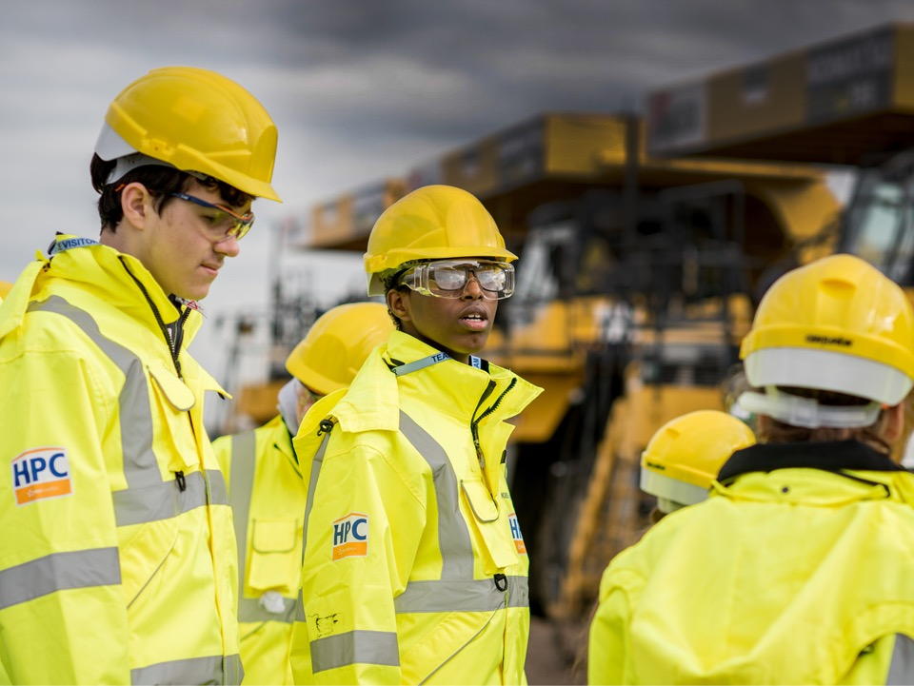
Could you see yourself working at Hinkley Point C?
Either during its construction or when it’s built?

Slide 3
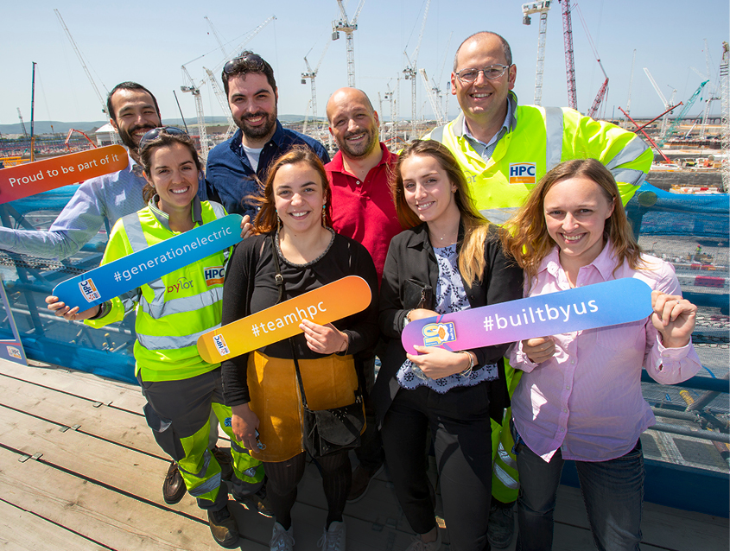
This could be YOU!

Slide 4

Do you want a job that
makes a difference?
Notes:
This is a CGI representation of how HPC will look when it’s built

Slide 5
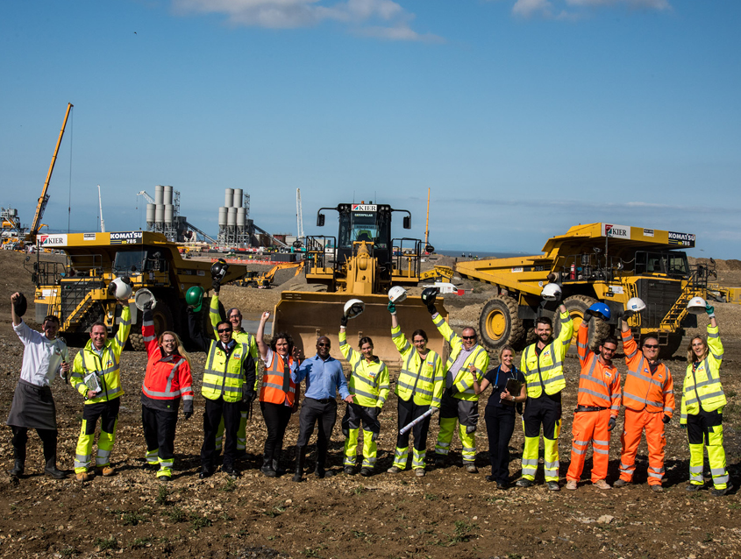
Do you want to work with interesting people?

Slide 6
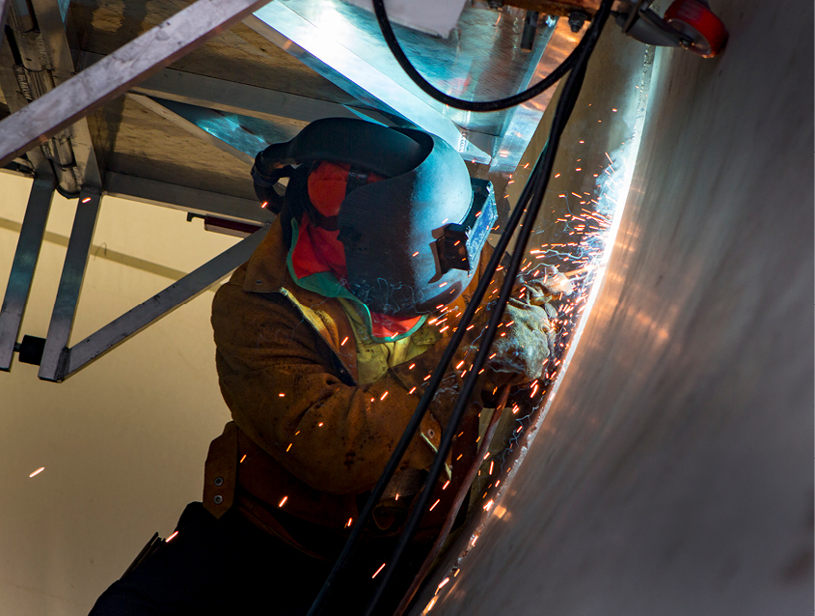
Do you want to earn a good salary and develop skills for life?

Slide 7
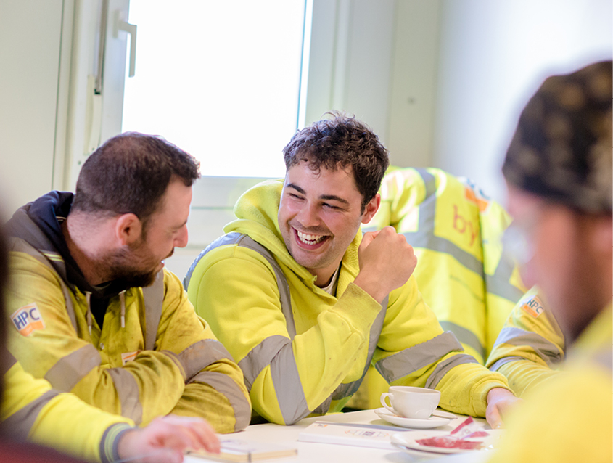
There’s a world of opportunities
at Hinkley Point C (HPC)

Slide 8
Not sure what you want to do yet?

Slide 9
Don’t worry!

Slide 10

“
During school and college I was uncertain about what career path I wanted to follow…
…I wanted the opportunity to achieve further qualifications
but also start working and gain experience.
”
Evie Wolford

Slide 11

Evie is now a Supply Chain Apprentice at HPC
“Starting my career on a project of this scale gives me the opportunity to work on a variety of teams to understand the different aspects of the role.”

Slide 12


Slide 13
Whatever you’re interested in –
there’s a role
at HPC for you

Slide 14
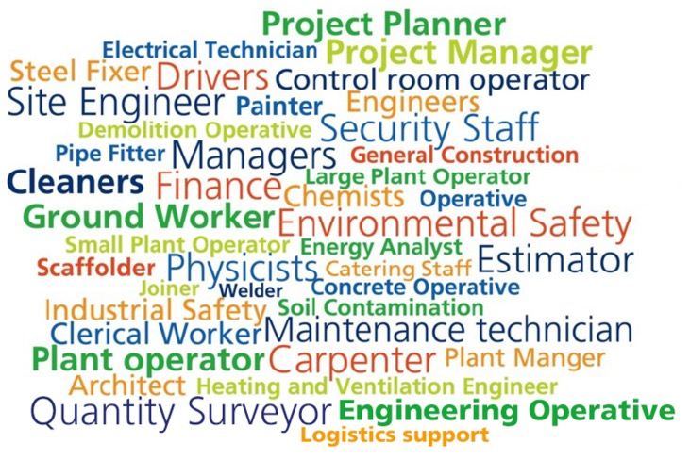
Whether you’re interested in…
Construction jobs

Slide 15

…Or operational jobs
when HPC is up and running

Slide 16
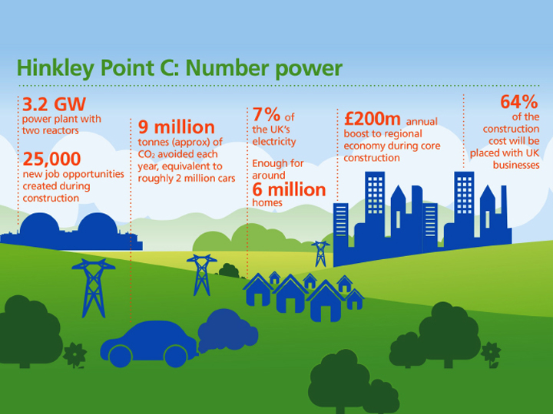

Slide 17
We’ll still be building HPC by the time you’ve left school…
…And need people like you to help build it

Slide 18
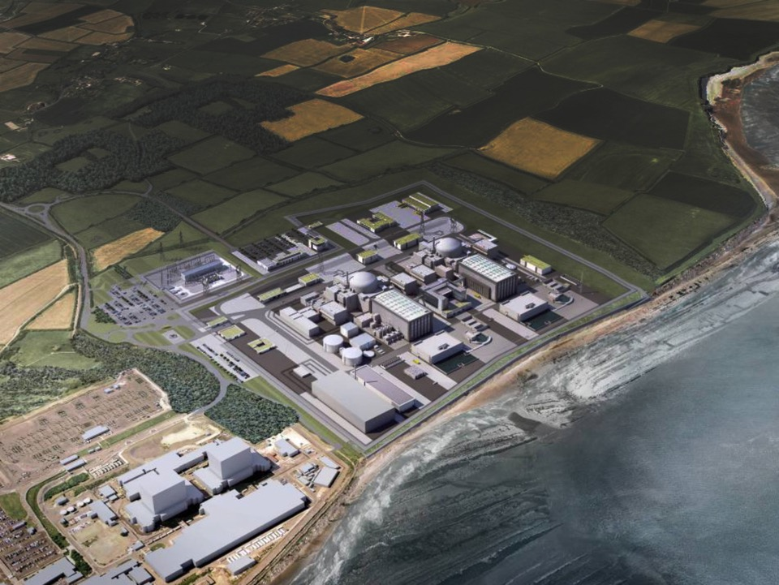
And then we’ll need you to help us run the power station during
its 60-year operation!
18

Slide 19
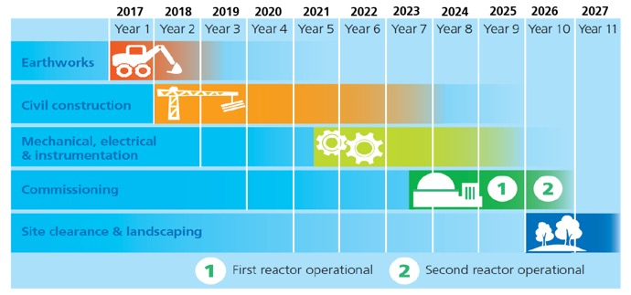
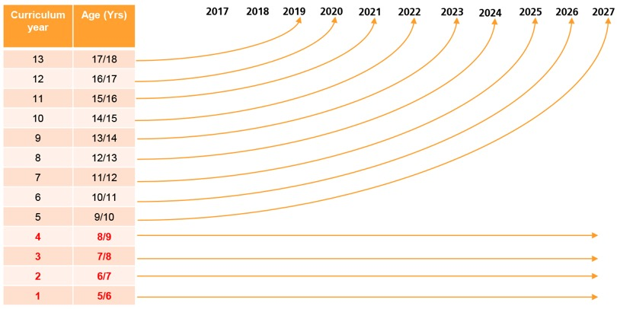
Notes:
This slide shows what roles we’ll need on site as each year group finishes school.
What stage of development will HPC be at when you leave school?

Slide 20
How YOU
can get a job
at HPC

Slide 21
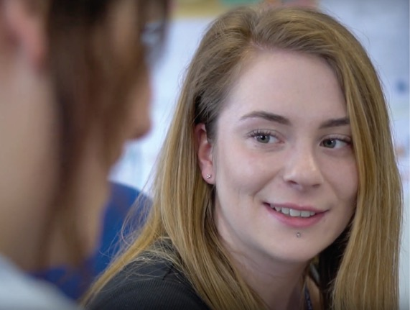
Notes:
Hear direct from three apprentices working at HPC on what it’s like to be an apprentice: https://www.youtube.com/watch?v=AjYE4ETO3zU

Slide 22
Apprenticeships

Slide 23
For 16+
Get paid
Learn on the job
Get qualifications
Get skills and experience

Slide 24

Notes:
This film debunks five myths about apprenticeships: https://youtu.be/ofCASOWA3O8

Slide 25
Degree Apprenticeships

Slide 26
For 18+
Get paid
Get a degree –
without paying tuition fees
Get qualifications
Get skills and experience

Slide 27
Graduate schemes

Slide 28
For 21+
Get paid
Apply learning
Get experience of
jobs across the project

Slide 29
“
The graduate scheme is a great opportunity to learn about all areas of the business. Some of my work has involved working with designers in France and has been accepted by our regulator. This really gives a sense that the work I’ve done has contributed to the team I was in.
”
Jessica Cliff, Science & Engineering Graduate

Slide 30
Info for
KS3
Notes:
Use the following slides (30-36) if you’re showing this assembly to Key Stage 3 students (and remove slides 37-44) to avoid duplication of some content.

Slide 31
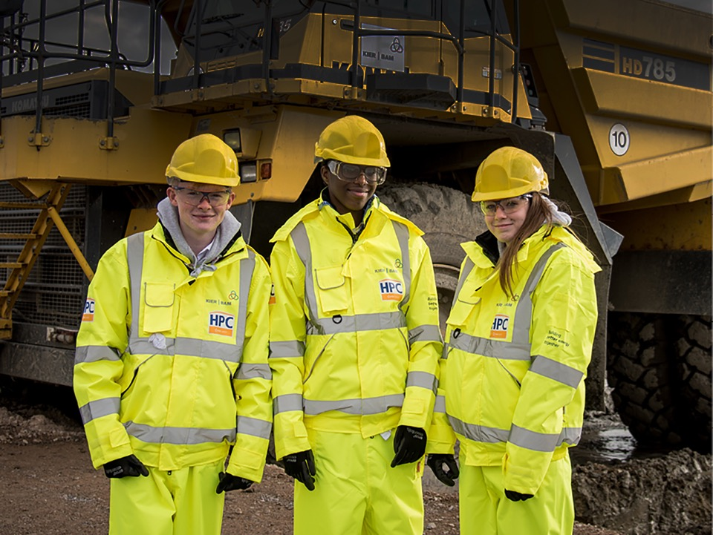
It’s never too early to think
about your future
Notes:
For Lower Secondary

Slide 32
Which subjects do you enjoy?
What jobs could they lead to?
What skills and qualifications do you have?
What activities do you do that develop your skills (e.g. DoE, volunteering etc.)?
Notes:
For Lower Secondary

Slide 33
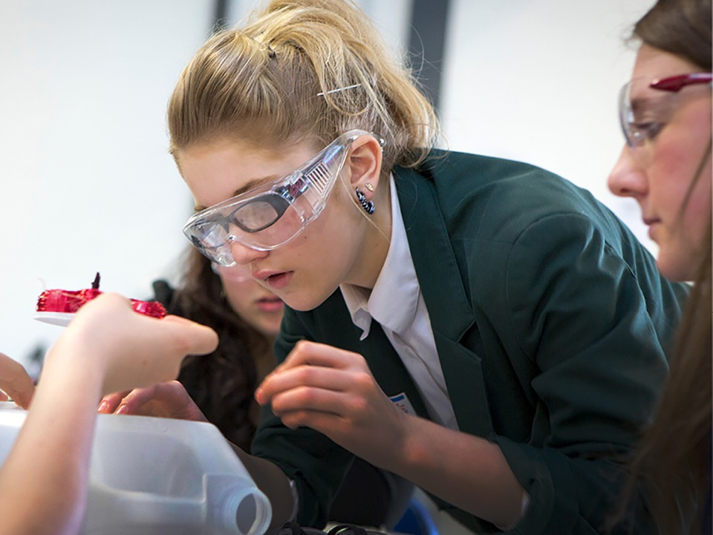
Stick with STEM
Notes:
For Lower Secondary

Slide 34



Keep up to date with
what’s going on at HPC
www.edfenergy.com/careers
Hinkley Point C
EDF Energy Careers
HinkleyPointC
@edfehinkleyc
@edfecareers
Notes:
For Lower Secondary

Slide 35

Come and talk to us
Notes:
For Lower Secondary

Slide 36
Take a free tour of Hinkley Point B or C
Come to the Hinkley Point visitor centre
Meet us at events and careers fairs
Join Young HPC when you’re 16
Notes:
For Lower Secondary

Slide 37
Info for
KS4
Notes:
Use the following slides (37-44) if you’re showing this assembly to Key Stage 4 students (and remove slides 30-36) to avoid duplication of some content.

Slide 38
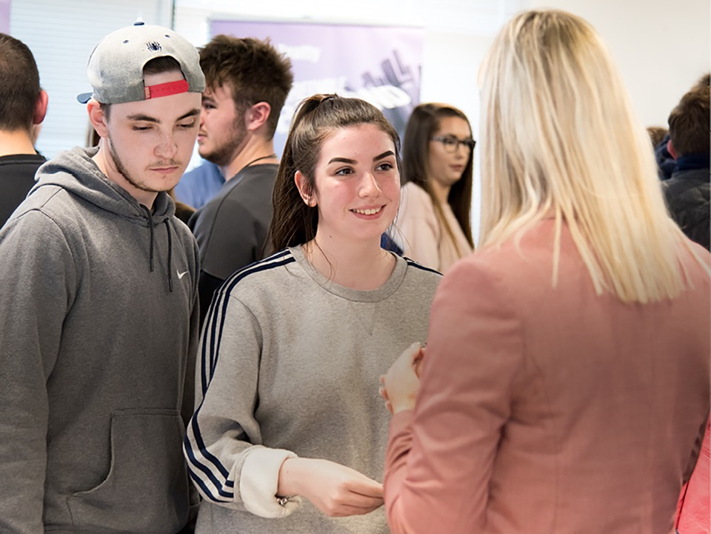
Start planning
your future
Notes:
For Upper Secondary

Slide 39
What could your subject choices lead to?
How can you build your skills?
What activities do you do that develop your skills (e.g. DoE, volunteering etc.)?
Where can you get work experience?

Slide 40

Join Young HPC
Notes:
For Upper Secondary

Slide 41


Slide 42
Keep up to date with
what’s going on at HPC
www.edfenergy.com/careers
Hinkley Point C
EDF Energy Careers
HinkleyPointC
@edfehinkleyc
@edfecareers
Notes:
For Upper Secondary

Slide 43
Come and talk to us
Notes:
For Lower Secondary

Slide 44
Take a free tour of Hinkley Point B or C
Come to the Hinkley Point visitor centre
Meet us at events, like the National Apprenticeship Show or careers fairs

Slide 45
Feedback questions for students:
Q. Raise your hand if you know more now about:
Hinkley Point C?
EDF Energy?
Careers in the nuclear industry?
Students can also share their feedback with us at https://www.surveymonkey.co.uk/r/GHPBW3R

Slide 46
Thank you
www.edfenergy.com/hinkley-point-c
Please share your feedback with us on this presentation so we can improve our resources at https://www.surveymonkey.co.uk/r/GP8GLBF

