Slide 1

HPC Inspire
Assembly for KS2
What the new power station at Hinkley Point C has to offer YOU
Notes:
This is an assembly from HPC Inspire that explains how the new power station being built at Hinkley Point C (HPC) will generate electricity – and what types of jobs will be available when today’s KS2 children come to leave school.

Slide 2
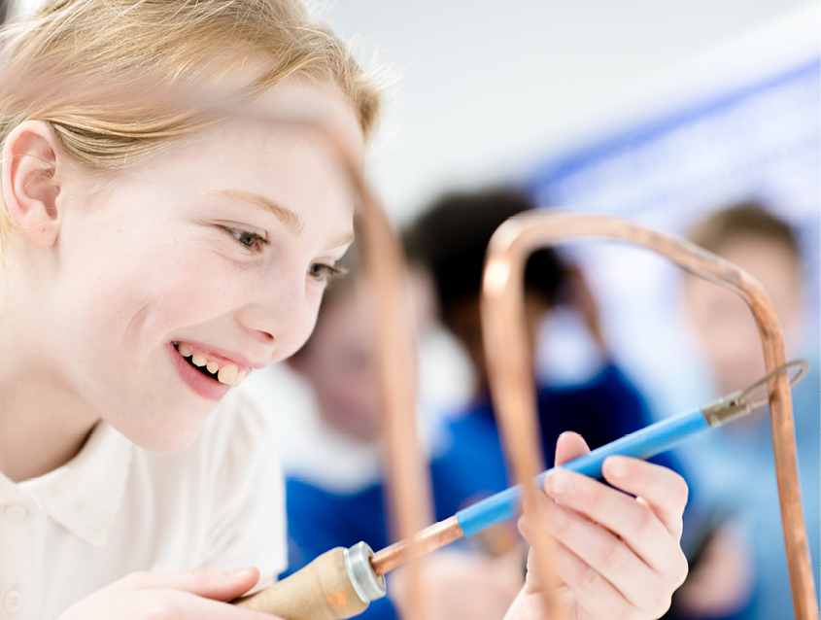
It’s never too
early to imagine your future
Notes:
There’s a whole world of exciting career possibilities out there for today’s children – and it’s never too early to think about them.

Slide 3
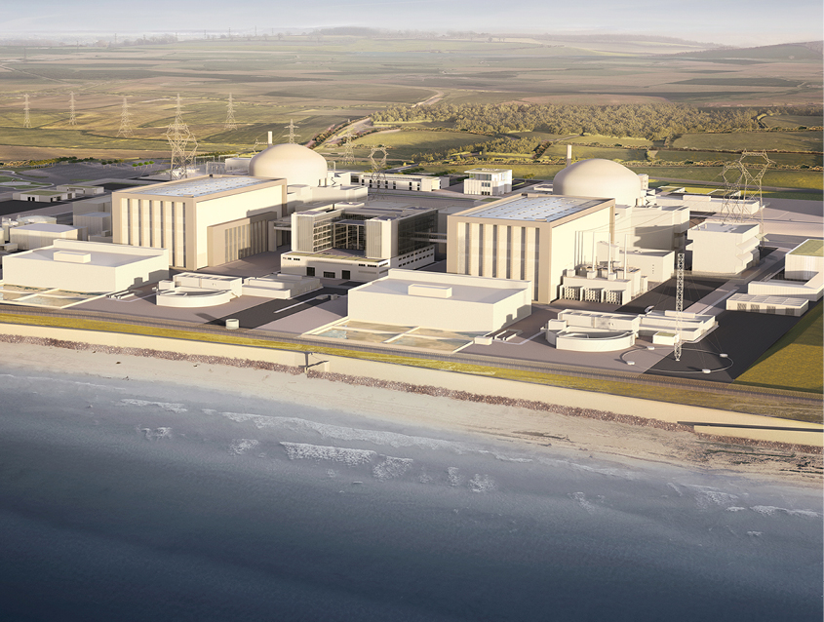
Do you know what this is?
Notes:
This is a CGI representation of what HPC will look like when complete.

Slide 4
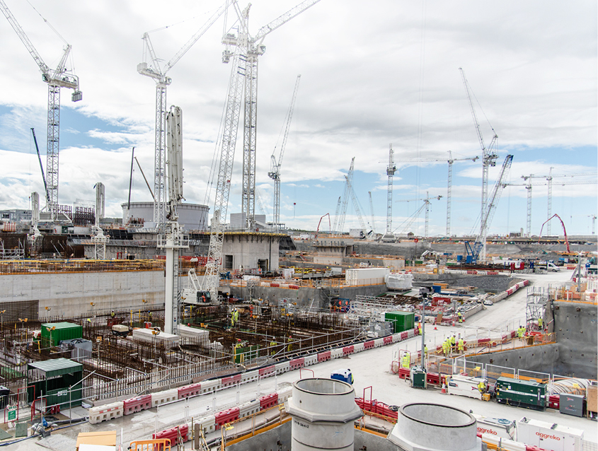
It’s Hinkley Point C (HPC):
a new nuclear power station
And we’re still building it – so it looks more
like this at the moment!
Notes:
At the moment, HPC is still a building site! But we have most of the foundations in place and are now building above ground.

Slide 5
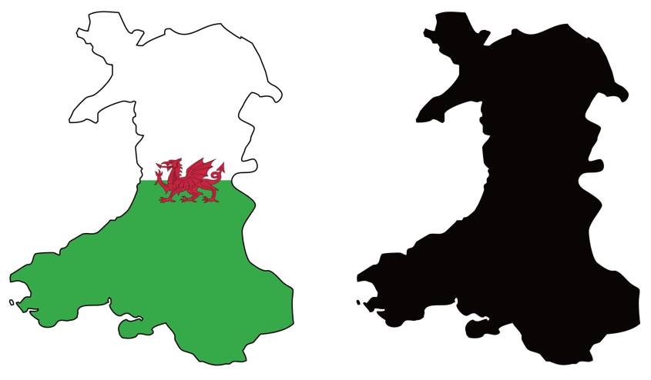
It will generate electricity for 6 million homes…
… That’s enough electricity to power
TWO times the number of homes in Wales!
Notes:
HPC will generate enough electricity for 6 million people: two times the population of Wales!

Slide 6
Are you listening at the back?

Slide 7
Make sure you pay attention…
We’ll be testing how many facts you can remember at the end of the presentation!
Notes:
We’ll be having a quick quiz at the end to see how much you can remember from the presentation.

Slide 8
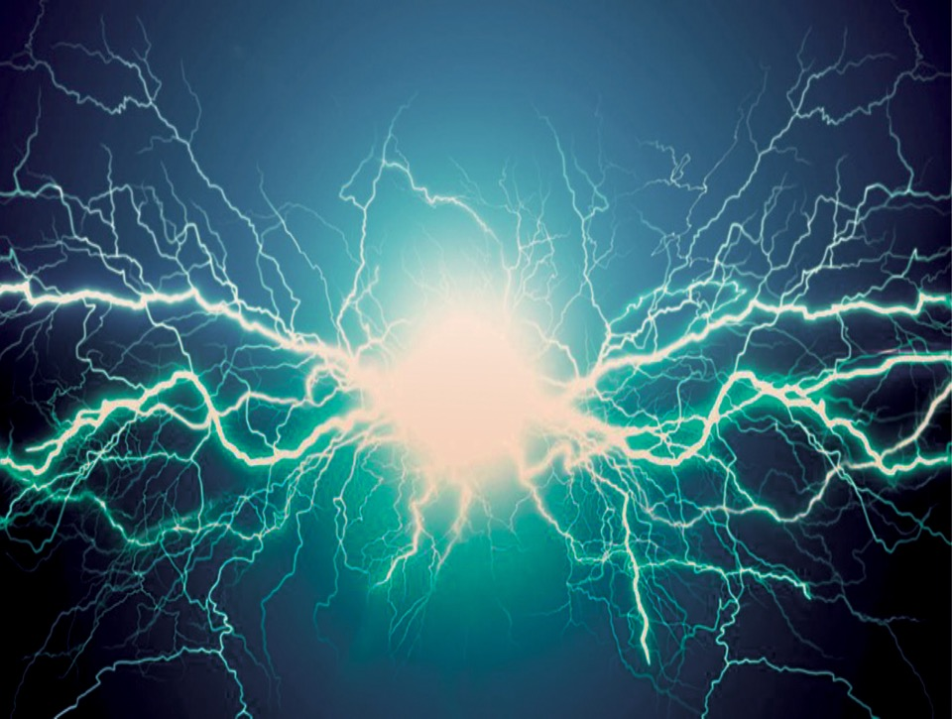
What do you know about electricity?
Electricity is created when tiny invisible things called electrons move. This flow is called an electric current.
Notes:
What do you know about electricity? Electricity is created when tiny invisible things called electrons move. This flow is called an electric current.

Slide 9
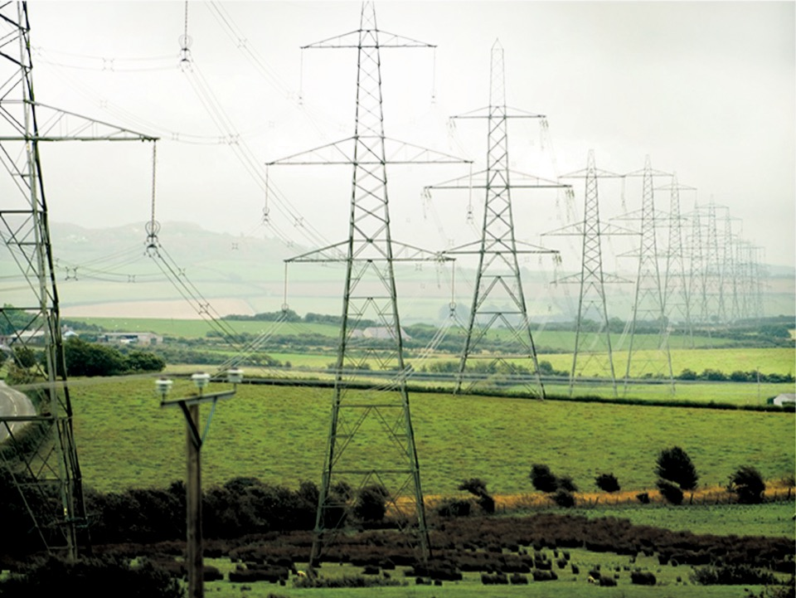
Have you seen one of these before?
They’re called pylons and they carry the electric current above ground. Electricity can also be carried underground through pipes.
Notes:
These are pylons and they carry the electric current above ground. Electricity can also be carried underground through pipes.

Slide 10



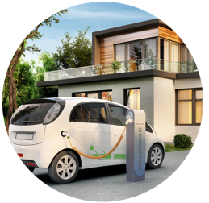
We use electricity for lots of things
Notes:
We use electricity for all sorts of things: 1) voice-activated devices, like Amazon Echo; 2) lamps and lighting (including smart lighting we control with our phones); 3) charging mobile phones and other devices; and 4) you can expect to see more of us charging our electric cars at home in the future too.
Image credits: iStockphoto and https://smarthomestore.edfenergy.com/collections/smart-home-voice-control/products/amazon-echo-dot-3rd-generation (Amazon Echo)

Slide 11
Can you name some of the things you’ve done this morning that used electricity?
Notes:
Can you name some of the things you’ve done this morning that used electricity? (You could ask children to raise their hands).

Slide 12
How do we produce electricity?

Slide 13

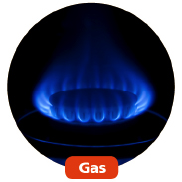
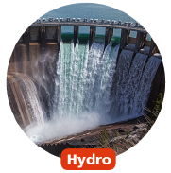
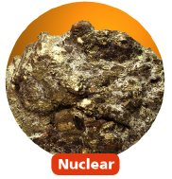

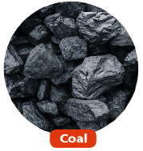
There are lots of ways in which we can generate electricity
Notes:
There are lots of ways in which we can generate electricity: solar (from the sun through solar panels), gas (a fossil fuel), hydro (from water), nuclear (from a metal called uranium), wind (through wind turbines) and coal (another fossil fuel).

Slide 14
At HPC we’ll be generating electricity from
nuclear power
Notes:
When HPC starts operating, we’ll be generating electricity from nuclear power.

Slide 15
But did you know the way we get heat from
nuclear power
is different to coal
and gas?
Notes:
How we generate electricity from nuclear power is different to how electricity is generated from coal and gas.

Slide 16
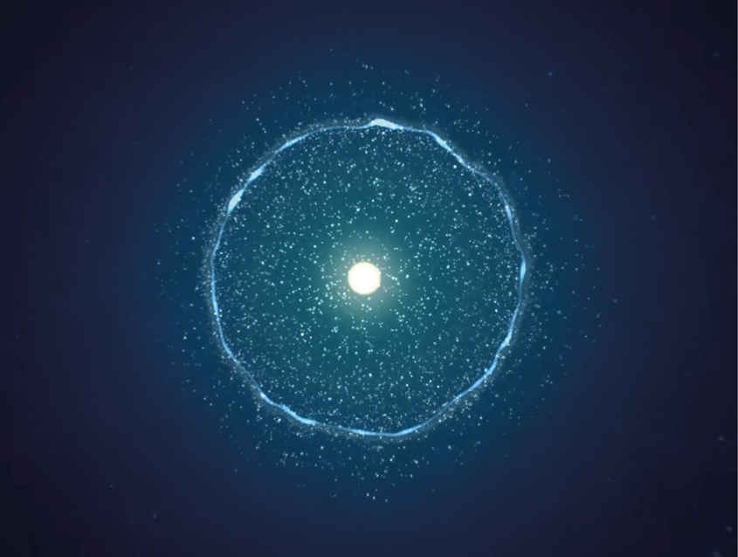
Watch this film to find out why…
Notes:
This virtual reality film explains how nuclear fission happens by recreating what happens inside a nuclear reactor: https://www.youtube.com/watch?v=6K5gy3RLcKc&t=

Slide 17
Do you know what’s also special about electricity produced from
nuclear power?

Slide 18
It’s low-carbon
Do you know what this means?

Slide 19
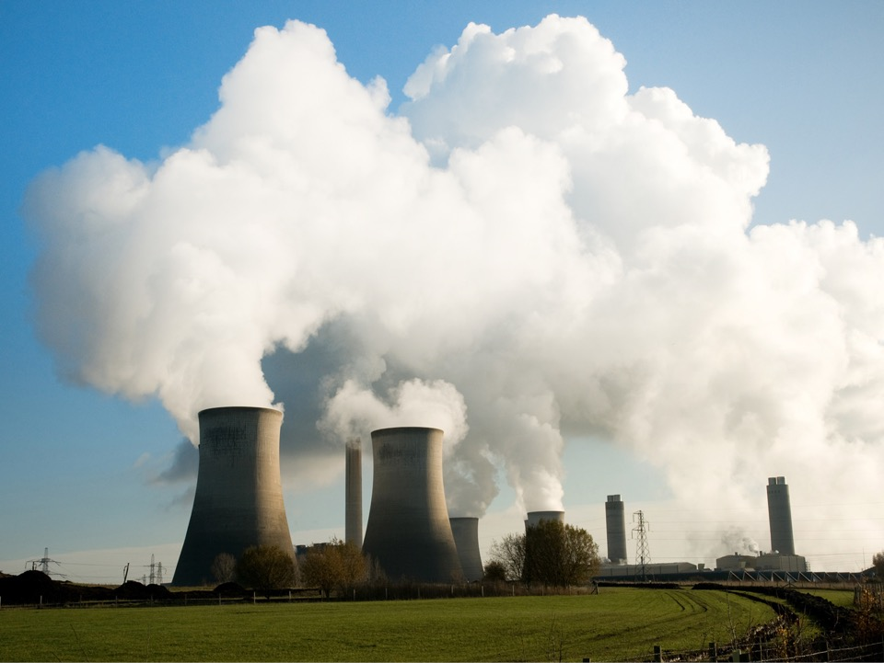
The electricity we’ll generate from nuclear power at HPC won’t release any gases that can harm our planet
Notes:
It’s low-carbon because the electricity we’ll generate from nuclear power at HPC won’t release any gases that can harm our planet – unlike burning fossil fuels (coal and gas) to produce electricity.

Slide 20
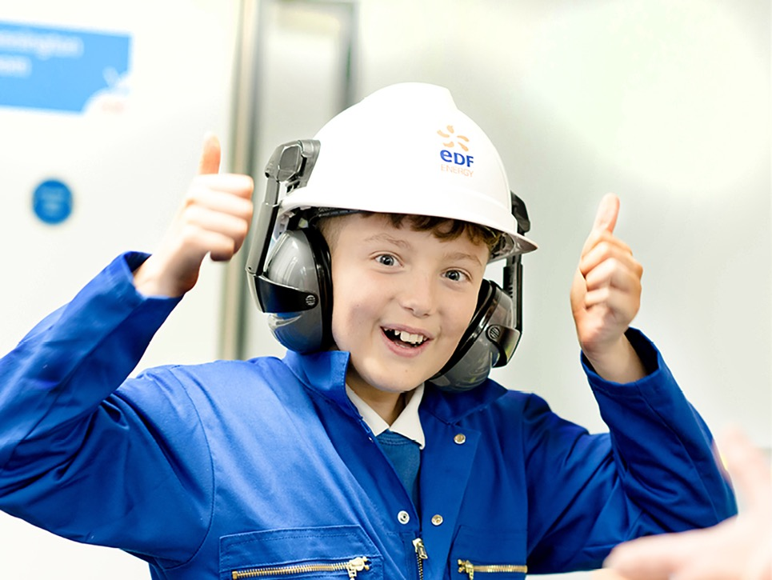
You’re too young to
get a job at HPC right now…

Slide 21
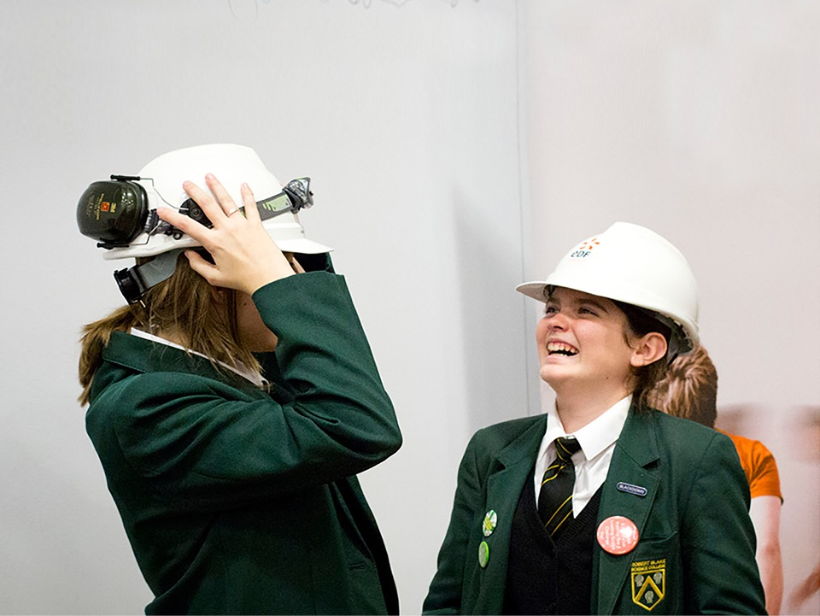
…But by the time HPC is built,
you’ll be thinking about getting a job
or going to university/college!

Slide 23
People like YOU, who enjoy:
Knowing how things work
Solving problems
Working with other people
Science, Technology, Maths
… and more!

Slide 24
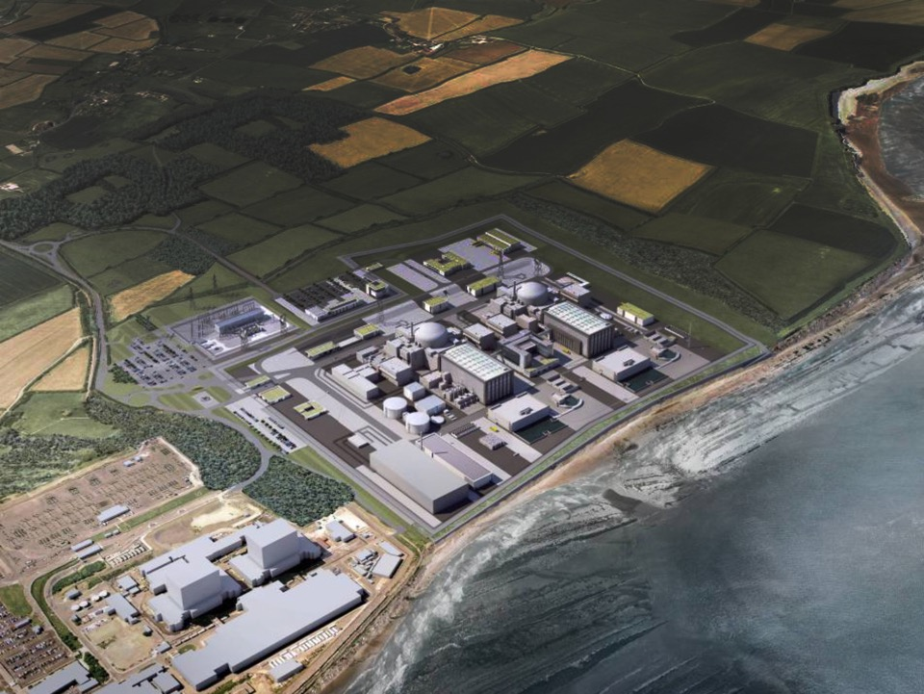
This is what HPC will look like when it’s finished…
24
Notes:
This is a CGI shot of what HPC will look like when it’s finished.

Slide 25
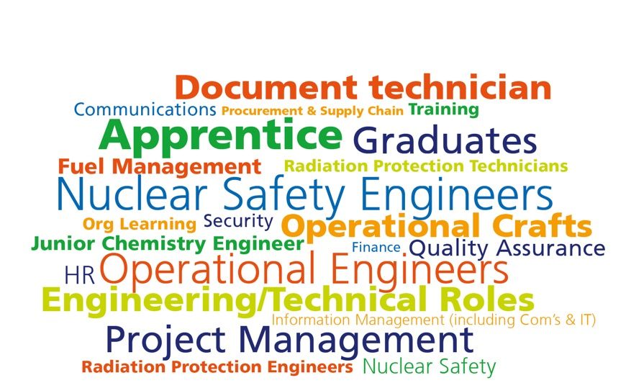
… And these are all the people we’ll need to work here

Slide 26
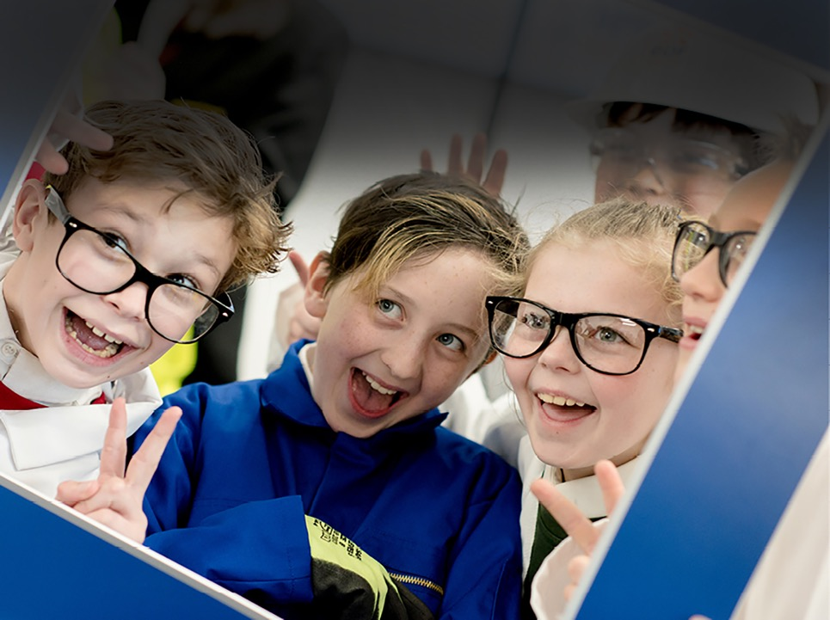
There are going to be all sorts of cool and interesting jobs in the future

Slide 27
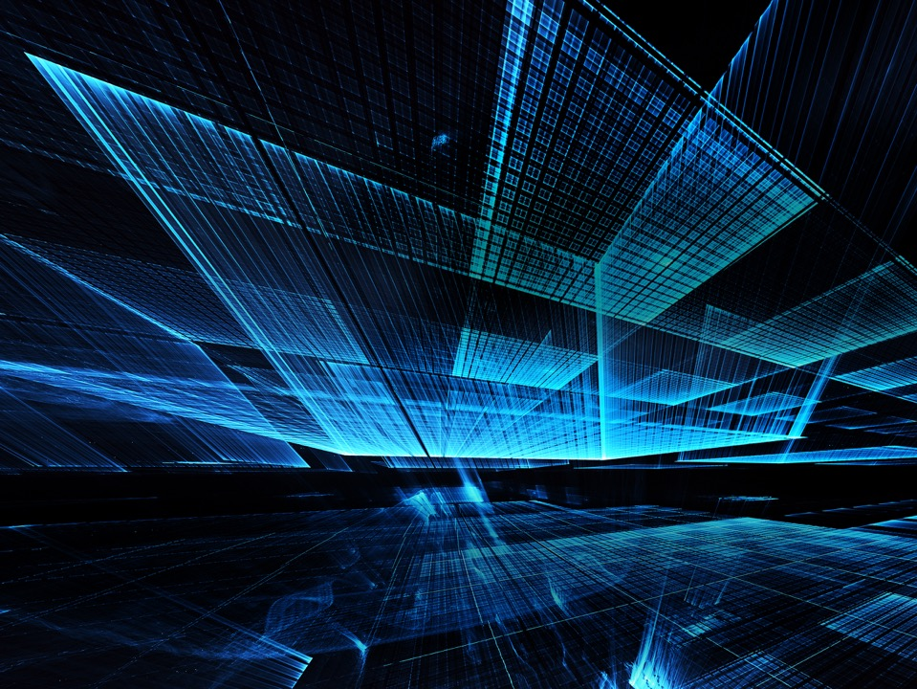
Imagine a job where you…
Create virtual worlds
Design state-of-the-art nuclear equipment
Code robots to fix machines
Develop cutting-edge safety tools
Manage an entire power station

Slide 28
What job will
YOU
do when you’re older?

Slide 29
Quiz time!

Slide 30
Q. How many homes will HPC provide electricity for?
2 million
4 million
6 million

Slide 31
A. 3) 6 million

Slide 32
Q. Electricity is created when tiny things called WHAT move?
Atoms
Electrons
Sparks

Slide 33
A. 2) Electrons

Slide 34
Q. At HPC, we’ll be generating electricity from WHAT?
Coal
Nuclear power
Rubbish

Slide 35
A. 2) Nuclear power

Slide 36
Feedback questions for students:
Q. Raise your hand if you know more now about:
Hinkley Point C?
EDF Energy?
Careers in the nuclear industry?
Students can also share their feedback with us at https://www.surveymonkey.co.uk/r/GH9XGCJ

Slide 37
Thank you
www.edfenergy.com/hinkley-point-c
Please share your feedback with us on this presentation so we can improve our resources at https://www.surveymonkey.co.uk/r/GHGVMSS

