Slide 1
A how-to guide to
eBilling

Slide 2
Downloading an eBill
eBill Reader
Amending report format

Slide 3
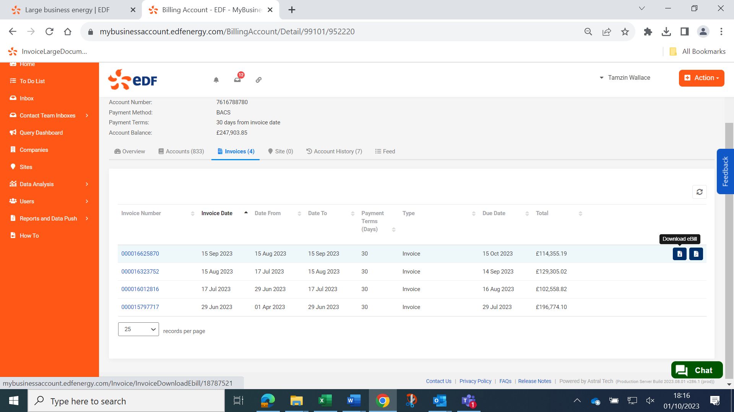


Downloading an eBill
1. Click ‘download eBill’
Complete the Site Additions Process
eBill Guide – October 2023 | PROTECT – PRIVATE | © 2023 EDF Energy Ltd. All Rights Reserved

Slide 4
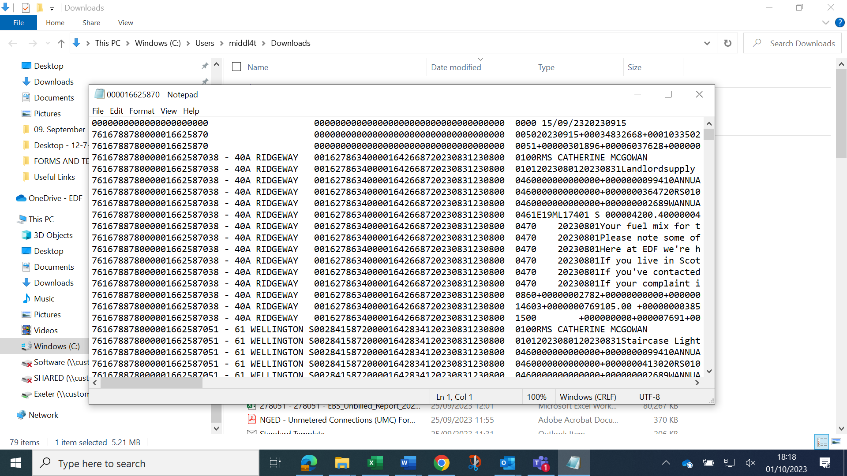
Downloading an eBill
2. Open using Notepad
Complete the Site Additions Process
eBill Guide – October 2023 | PROTECT – PRIVATE | © 2023 EDF Energy Ltd. All Rights Reserved

Slide 5
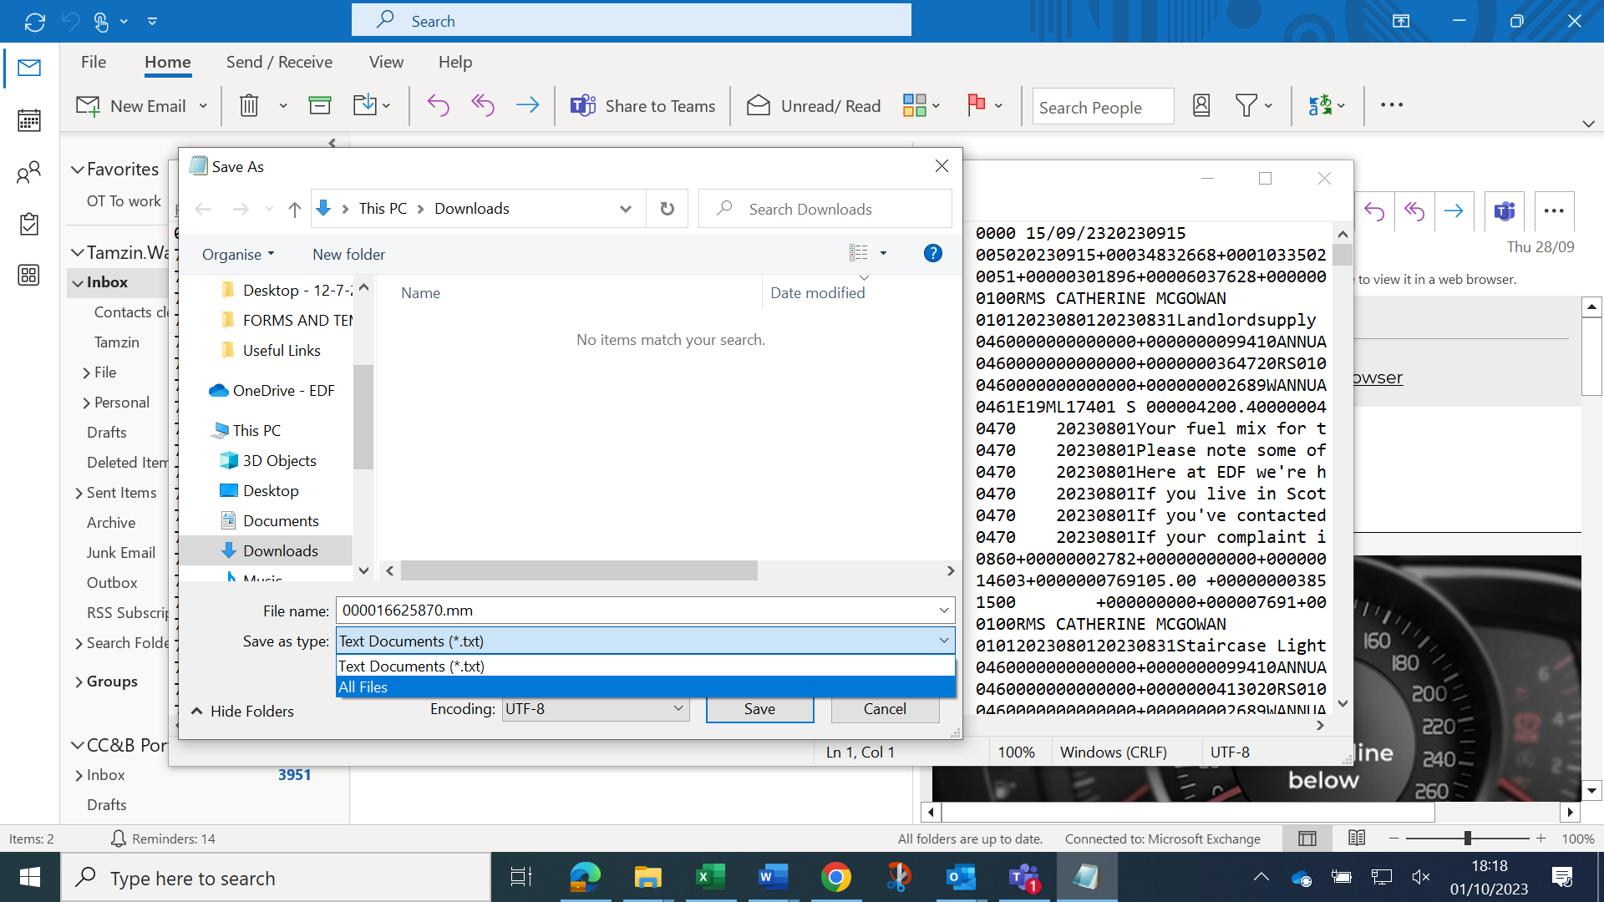
Downloading an eBill
3. Save as .mm file
Add .mm to the end of the file name and select ‘All Files’ from the drop down box. Save to your desktop or preferred folder.
Complete the Site Additions Process
eBill Guide – October 2023 | PROTECT – PRIVATE | © 2023 EDF Energy Ltd. All Rights Reserved

Slide 6
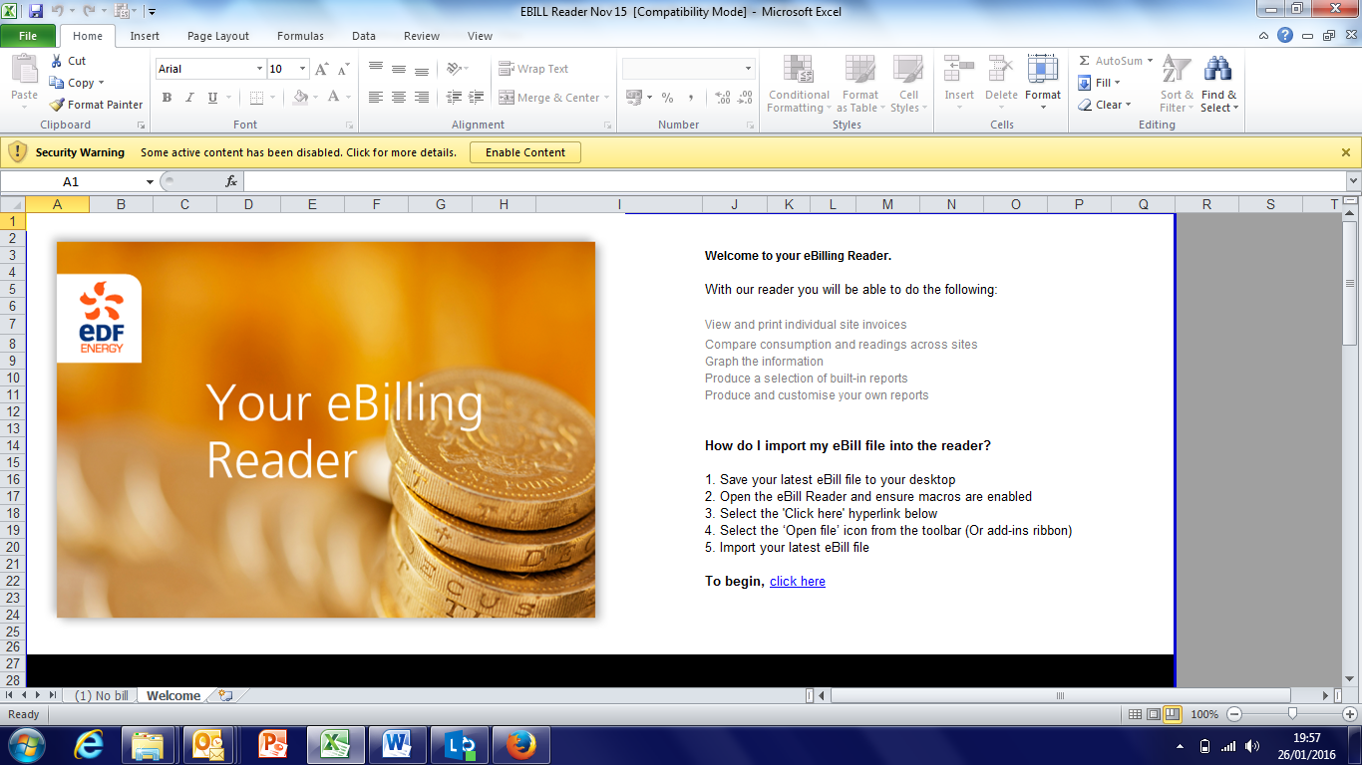
eBill Reader
1. Save the reader to your C:Drive
The eBill reader is free software from EDF which translates the monthly .mm file into Excel for you. This can be used for your routine .mm file (bill) or your portfolio report, if you receive one.
Remember to Enable Content
Complete the Site Additions Process
eBill Guide – October 2023 | PROTECT – PRIVATE | © 2023 EDF Energy Ltd. All Rights Reserved

Slide 7
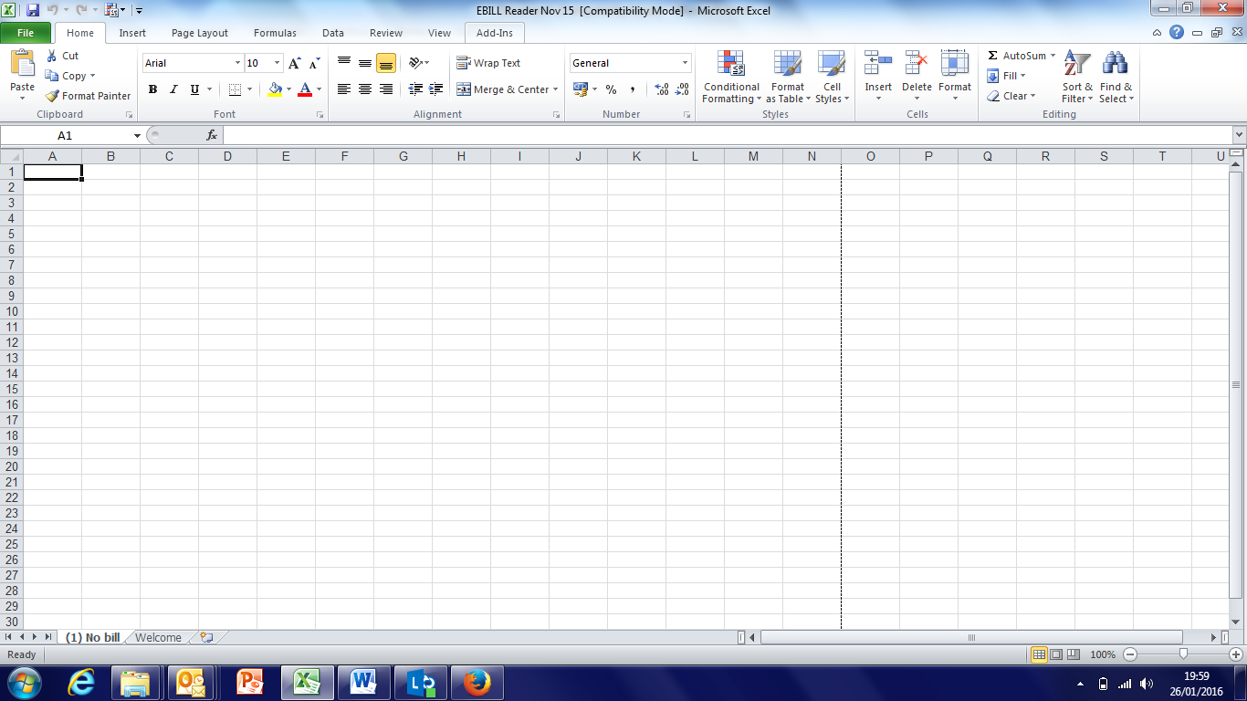
eBill Reader
2. Make sure you click Add-Ins
Complete the Site Additions Process
eBill Guide – October 2023 | PROTECT – PRIVATE | © 2023 EDF Energy Ltd. All Rights Reserved

Slide 8
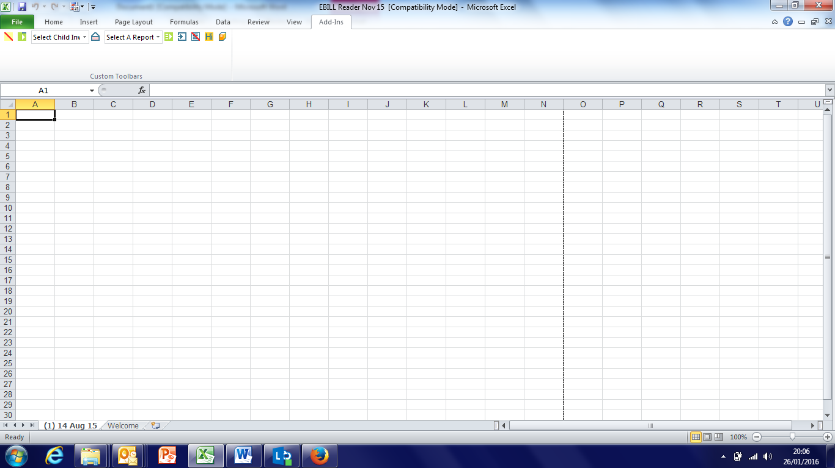
eBill Reader
3. Click the Green button
Note: you might find the green button at the bottom of the page instead of the top.
Complete the Site Additions Process
eBill Guide – October 2023 | PROTECT – PRIVATE | © 2023 EDF Energy Ltd. All Rights Reserved

Slide 9
eBill Reader
3. Choose your account/s and report
4. Click the green button again
Complete the Site Additions Process
eBill Guide – October 2023 | PROTECT – PRIVATE | © 2023 EDF Energy Ltd. All Rights Reserved

Slide 10
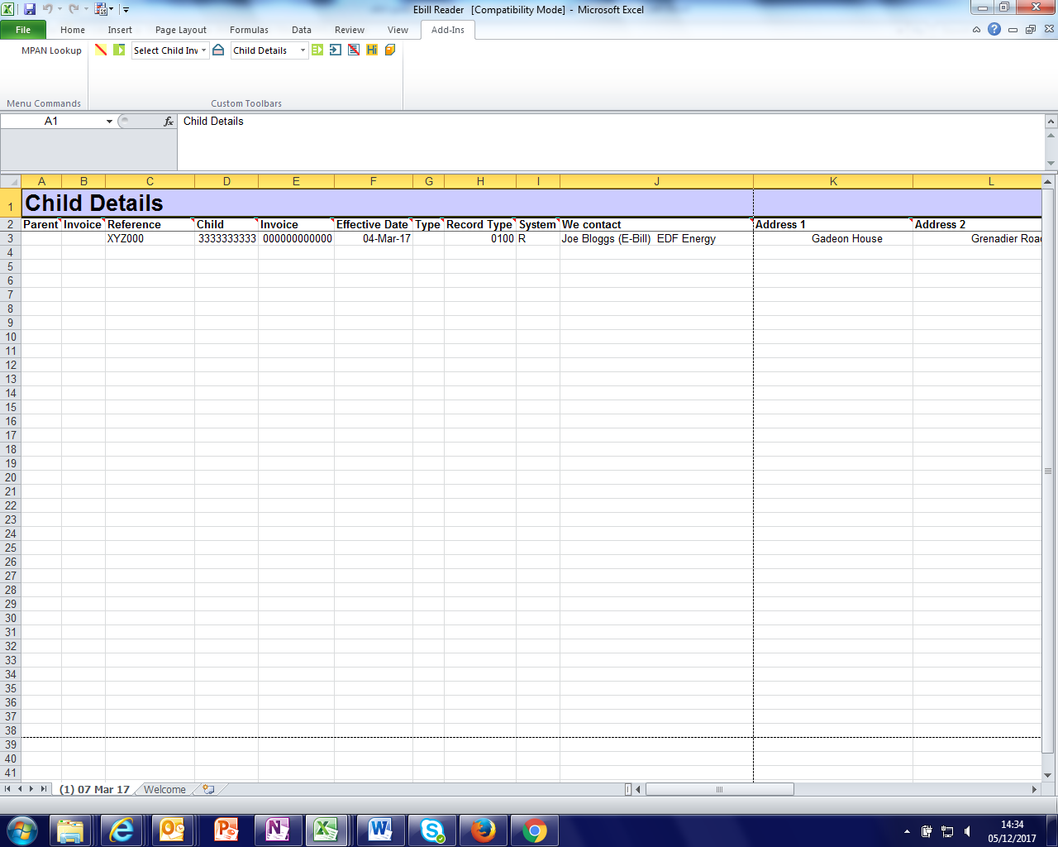
Amending the format
1. Open your eBill as normal – click the orange button
Complete the Site Additions Process
eBill Guide – October 2023 | PROTECT – PRIVATE | © 2023 EDF Energy Ltd. All Rights Reserved

Slide 11
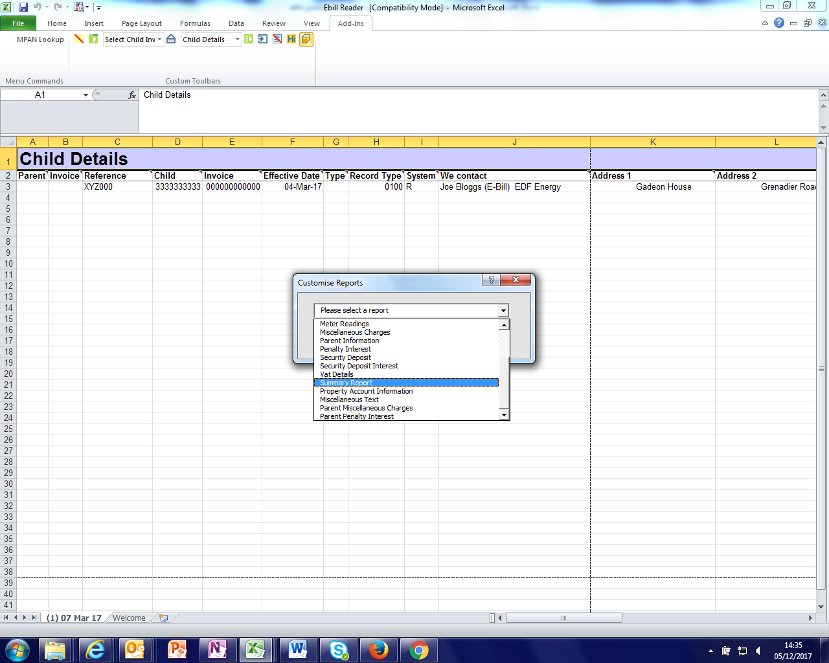
Amending the format
2.Choose which report you want to change the format of in the drop down box
Complete the Site Additions Process
eBill Guide – October 2023 | PROTECT – PRIVATE | © 2023 EDF Energy Ltd. All Rights Reserved

Slide 12
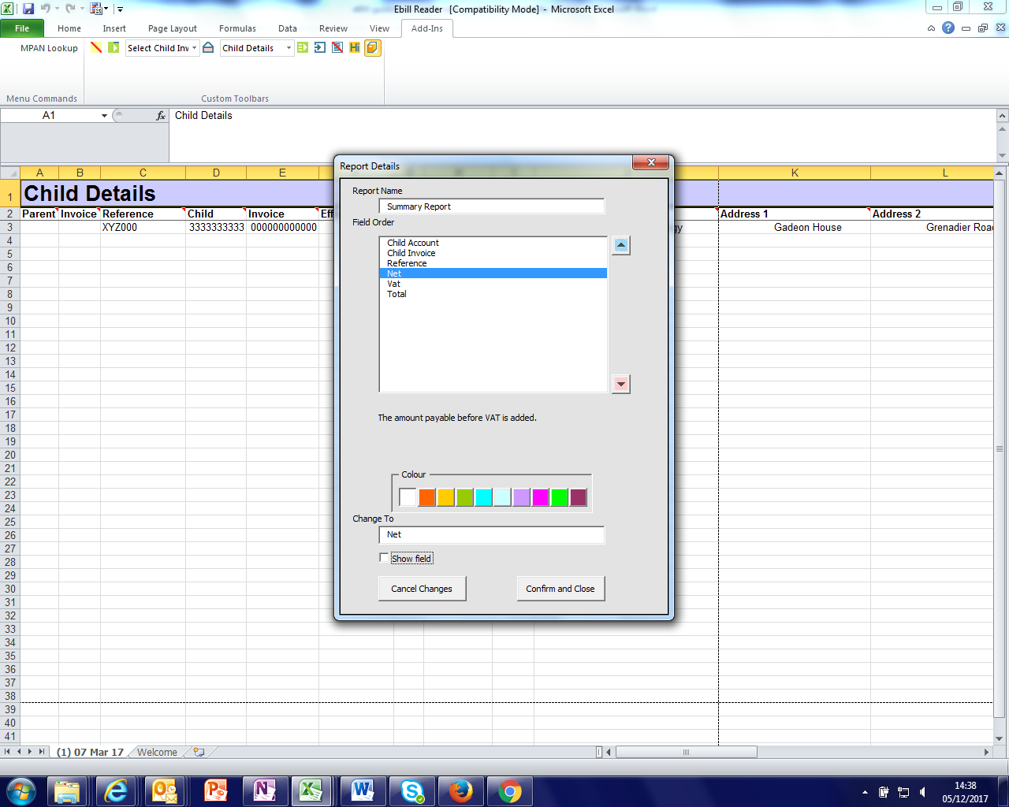
Amending the format
3. Choose which fields you do not wish to see in your new report
4. Untick the ‘show field’ box
eBill Guide – October 2023 | PROTECT – PRIVATE | © 2023 EDF Energy Ltd. All Rights Reserved

Slide 13
Amending the format
5. Highlight certain criteria if you wish
6. Confirm and close
Note - You can change the view of any report within the eBill reader if you choose.
eBill Guide – October 2023 | PROTECT – PRIVATE | © 2023 EDF Energy Ltd. All Rights Reserved

