Slide 1
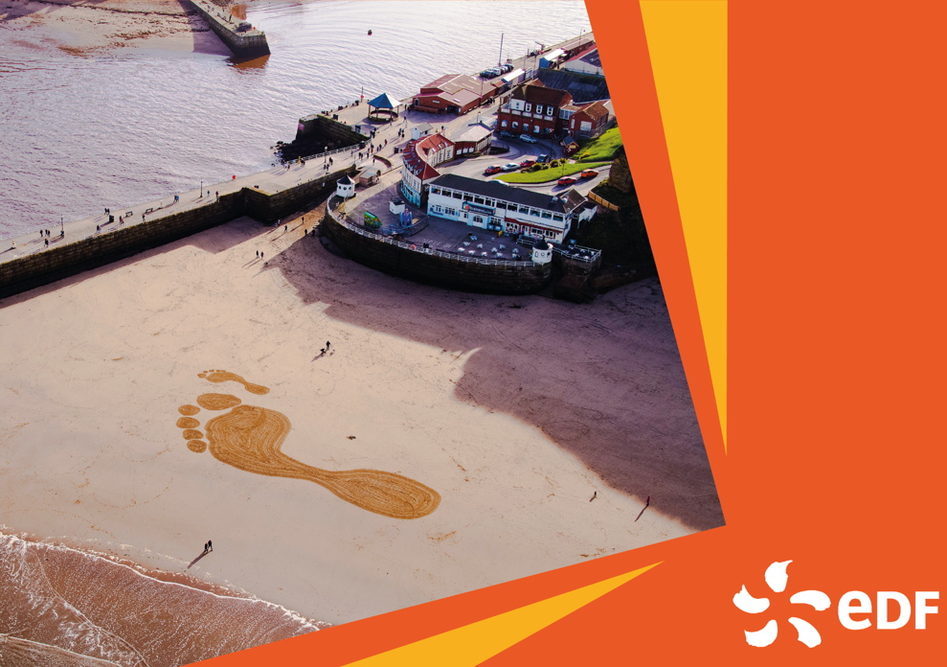
A Question of Net Zero
Notes:
Thanks to the Department of Change for creating the original version of this quiz for EDF.

Slide 2
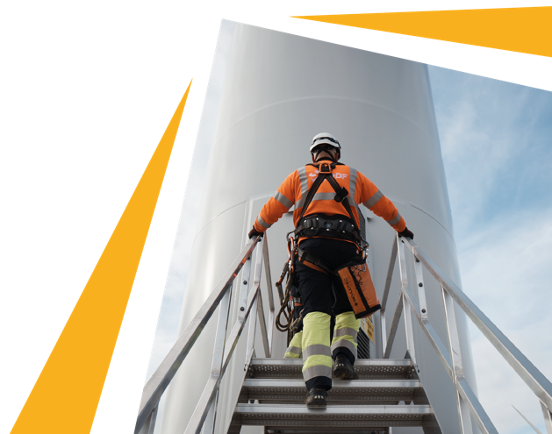
The rounds
1. The warm-up
2. How big are your CO₂ shoes?
3. Mission: Net Zero
2
A Question of Net Zero | NOT PROTECTIVELY MARKED* © Copyright 2019 NNB Generation Company (HPC) Limited. All rights reserved.

Slide 3
“In our hands now lies not only our own future, but that of all living creatures with whom we share the Earth.”
Sir David Attenborough
3
A Question of Net Zero | NOT PROTECTIVELY MARKED* © Copyright 2019 NNB Generation Company (HPC) Limited. All rights reserved.
Notes:
Here’s a quote from the great Sir David Attenborough.
This quiz is about understanding how climate change could affect us – but also, what we can do about it.

Slide 4
Round 1: The warm-up
4
A Question of Net Zero | NOT PROTECTIVELY MARKED* © Copyright 2019 NNB Generation Company (HPC) Limited. All rights reserved.

Slide 5
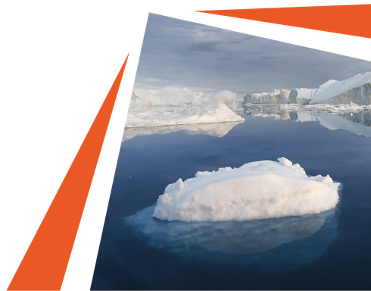
Q1
The Earth’s temperature has increased by 1°C since 1880. How much of this rise has happened since 1975?
A. One quarter
B. One half
C. Two thirds
D. All of it
5
A Question of Net Zero | NOT PROTECTIVELY MARKED* © Copyright 2019 NNB Generation Company (HPC) Limited. All rights reserved.
Notes:
If you want to set the scene… Share this article from Nasa (https://earthobservatory.nasa.gov/world-of-change/global-temperatures) with students, which also has a short animation showing how much the world has warmed up since 1880.

Slide 6
Q2
At the current rate of warming, how much will the Earth’s temperature have risen by in 2100?
A. 1°C
B. 2°C
C. 3°C
D. 5°C
6
A Question of Net Zero | NOT PROTECTIVELY MARKED* © Copyright 2019 NNB Generation Company (HPC) Limited. All rights reserved.
Notes:
If you want to set the scene… Share this article from BBC News – it features lots of useful context and graphs to explain what’s happening visually: https://www.bbc.co.uk/news/science-environment-46384067

Slide 7
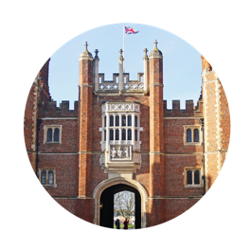
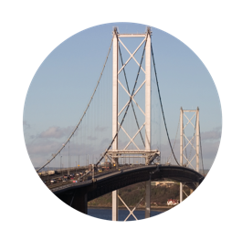
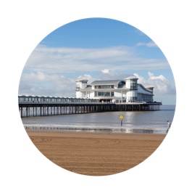
Q3
If we do nothing, rising sea levels will make these British landmarks inaccessible by 2100. Can you name them?
E
A
C
A bridge in NE England, built in 1928
B
D
A London palace and former home of Henry VIII
The world’s longest canti-levered bridge
A 96-mile coastline famous for its fossils
A coastal town with a 366m long pier
7
A Question of Net Zero | NOT PROTECTIVELY MARKED* © Copyright 2019 NNB Generation Company (HPC) Limited. All rights reserved.
Notes:
If you want to set the scene… Share this URL: https://coastal.climatecentral.org Use the toggle and zoom functionality to see which areas will be underwater by 2100.

Slide 8
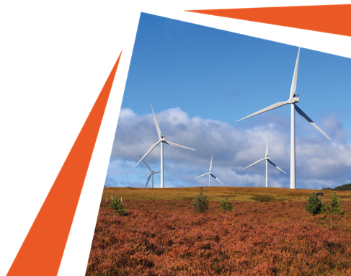
Q4
If we act quickly and decisively now, how much could we limit warming to?
A. 0.5°C
B. 1°C
C. 1.5°C
D. 2°C
8
A Question of Net Zero | NOT PROTECTIVELY MARKED* © Copyright 2019 NNB Generation Company (HPC) Limited. All rights reserved.
Notes:
If you want to set the scene… Refer back to this article, if needed, from BBC News: https://www.bbc.co.uk/news/science-environment-46384067

Slide 9
ANSWERS
Q1
The Earth’s temperature has increased by 1°C since 1880. How much of this rise has happened since 1975?
Q2
At the current rate of warming, how much will the Earth’s temperature have risen by in 2100?
Q3
If we do nothing, rising sea levels will make these British landmarks inaccessible by 2100. Can you name them?
A. One quarter
B. One half
C. Two thirds
D. All of it
A. 1°C
B. 2°C
C. 3°C
D. 5°C
A.
Tyne Bridge
B.
Jurassic Coast
C.
Forth Road Bridge
Q4
If we act quickly and decisively now, how much could we limit warming to?
Weston Super Mare
D.
A. 0.5°C
B. 1°C
C. 1.5°C
D. 2°C
E.
Hampton Court Palace
9
A Question of Net Zero | NOT PROTECTIVELY MARKED* © Copyright 2019 NNB Generation Company (HPC) Limited. All rights reserved.
Notes:
Note to Question 2: Current predictions are that the Earth's temperature will rise by 3 degrees, but some think it could be as much as 5 degrees if we do nothing.

Slide 10
Round 1: Let’s talk about this
A remote part of the world hit a record 38°C in June 2020.
Can you guess where it is?
10
A Question of Net Zero | NOT PROTECTIVELY MARKED* © Copyright 2019 NNB Generation Company (HPC) Limited. All rights reserved.
Notes:
See the accompanying teachers’ notes for discussion points

Slide 11
Round 2: How big are your CO₂ shoes?
11
A Question of Net Zero | NOT PROTECTIVELY MARKED* © Copyright 2019 NNB Generation Company (HPC) Limited. All rights reserved.

Slide 12
Q1
What’s the average British person’s annual carbon footprint?
A
A. 5 tonnes
B. 13 tonnes
C. 2 tonnes
D. 25 tonnes
12
A Question of Net Zero | NOT PROTECTIVELY MARKED* © Copyright 2019 NNB Generation Company (HPC) Limited. All rights reserved.
Notes:
If you want to set the scene… Share this fascinating blog with students: https://www.pawprint.eco/eco-blog/average-carbon-footprint-uk

Slide 13
Q2
One tonne of CO₂ is the equivalent of a flight from London to where?
A. New York
B. Dublin
C. Cyprus
D. Malaga
13
A Question of Net Zero | NOT PROTECTIVELY MARKED* © Copyright 2019 NNB Generation Company (HPC) Limited. All rights reserved.
Notes:
If you want to set the scene… This analysis from the Guardian examines how much CO₂ one return flight generates: https://www.theguardian.com/environment/ng-interactive/2019/jul/19/carbon-calculator-how-taking-one-flight-emits-as-much-as-many-people-do-in-a-year

Slide 14
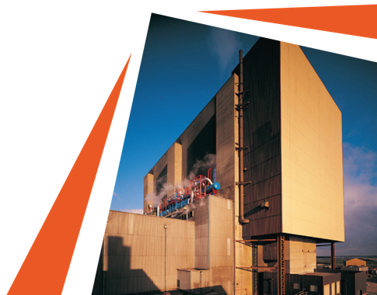
Q3
To limit global warming to 1.5°C, how much do we need to reduce our carbon footprint to?
A. 5 tonnes
B. 8 tonnes
C. 6 tonnes
D. 2 tonnes
14
A Question of Net Zero | NOT PROTECTIVELY MARKED* © Copyright 2019 NNB Generation Company (HPC) Limited. All rights reserved.
Notes:
If you want to set the scene… This site has lots of useful information and includes a carbon footprint calculator too: https://www.nature.org/en-us/get-involved/how-to-help/carbon-footprint-calculator/

Slide 15
Q4
Which of these contributes most to the average Brit’s carbon footprint?
A. Heating and powering our homes
B. Fuelling our cars
C. Food and drink from shops
D. Buying stuff
15
A Question of Net Zero | NOT PROTECTIVELY MARKED* © Copyright 2019 NNB Generation Company (HPC) Limited. All rights reserved.
Notes:
If you want to set the scene… Look at this article and scroll down to the pie chart for the breakdown of stats: https://www.pawprint.eco/eco-blog/average-carbon-footprint-globally

Slide 16
ANSWERS
Q1
What’s the average British person’s annual carbon footprint?
Q2
One tonne of CO₂ is the equivalent of a flight from London to where?
A. 5 tonnes
B. 13 tonnes
C. 2 tonnes
D. 25 tonnes
A. New York
B. Dublin
C. Cyprus
D. Malaga
Q3
To limit global warming to 1.5°C, how much do we need to reduce our carbon footprint to?
Q4
Which of these contributes most to the average Brit’s carbon footprint?
A. Heating and powering our homes
B. Fuelling our cars
C. Food and drink from shops
D. Buying stuff
A
A. 5 tonnes
B. 8 tonnes
C. 6 tonnes
D. 2 tonnes
16
A Question of Net Zero | NOT PROTECTIVELY MARKED* © Copyright 2019 NNB Generation Company (HPC) Limited. All rights reserved.
Notes:
NB: Some sources put the average British person’s footprint at 9 tonnes per person, but this only takes into account emissions caused in this country. If we include the emissions involved in manufacturing and importing consumer goods, this rises to 13 tonnes of CO₂.

Slide 17
Round 2: Let’s talk about this
What’s your carbon footprint?
Where does the average
Brit’s footprint come from?
Food and drink = ?
Heating and powering our homes = ?
Personal vehicles = ?
Personal flights = ?
Buying stuff = ?
Health, education and public services = ?
Other travel, home, waste, water, sewage = ?
Source: ’How Bad Are Bananas?’ Mike Berners Lee
17
A Question of Net Zero | NOT PROTECTIVELY MARKED* © Copyright 2019 NNB Generation Company (HPC) Limited. All rights reserved.

Slide 18
Round 3: Mission: Net Zero
18
A Question of Net Zero | NOT PROTECTIVELY MARKED* © Copyright 2019 NNB Generation Company (HPC) Limited. All rights reserved.

Slide 19
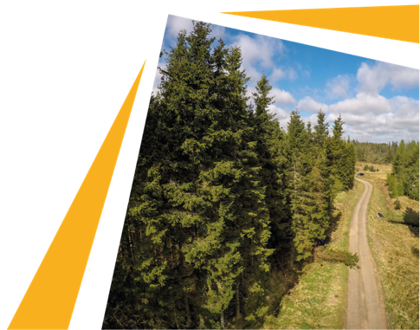
Q1
What’s the correct definition of Net Zero?
A. We reduce all our carbon emissions to zero
B. We reduce carbon emissions to a minimum, and balance any we do emit by removing an equal amount
C. We can emit as much carbon as we want, as long as we offset it
D. We only ever use renewable energy sources
19
A Question of Net Zero | NOT PROTECTIVELY MARKED* © Copyright 2019 NNB Generation Company (HPC) Limited. All rights reserved.
Notes:
To set the scene… The Energy Saving Trust’s blog on net zero and how we can reach it has lots of useful information presented in an easy-to-understand format: https://energysavingtrust.org.uk/what-is-net-zero-and-how-can-we-get-there/

Slide 20
Q2
Which was the first major economy to sign a commitment to Net Zero into law?
A. USA
B. Britain
C. Germany
D. New Zealand
20
A Question of Net Zero | NOT PROTECTIVELY MARKED* © Copyright 2019 NNB Generation Company (HPC) Limited. All rights reserved.
Notes:
To set the scene… Revisit the Energy Saving Trust blog if you’ve not shared this already: https://energysavingtrust.org.uk/what-is-net-zero-and-how-can-we-get-there/

Slide 21
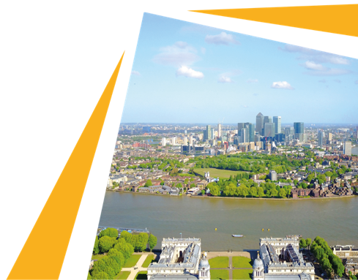
Q3
When has Britain committed to achieving Net Zero by?
A. 2050
B. 2030
C. 2040
D. 2100
21
A Question of Net Zero | NOT PROTECTIVELY MARKED* © Copyright 2019 NNB Generation Company (HPC) Limited. All rights reserved.
Notes:
To set the scene… See the notes in the previous slides.

Slide 22
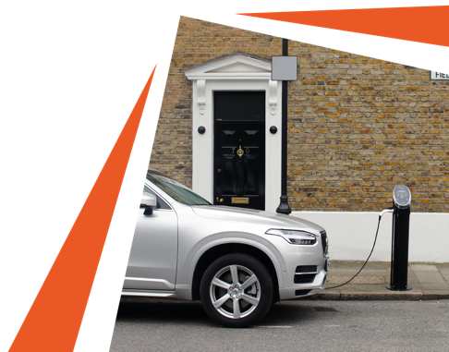
Q4
What are the most effective things we can do to reach Net Zero?
A. Use low carbon energy sources for heating
B. Reduce meat consumption
C. Switch to electric vehicles
D. Plant more trees and forests
E. All of the above
22
A Question of Net Zero | NOT PROTECTIVELY MARKED* © Copyright 2019 NNB Generation Company (HPC) Limited. All rights reserved.
Notes:
NB: This is a trick question! (See the next slide)

Slide 23
ANSWERS
Q1
What’s the correct definition of Net Zero?
Q2
Which was the first major economy to sign a commitment to Net Zero into law?
A. We reduce all our carbon emissions to zero
B. We reduce carbon emissions to a minimum, and balance any we do emit by removing an equal amount
C. We can emit as much carbon as we want, as long as we offset it
D. We only ever use renewable energy sources
A. USA
B. Britain
C. Germany
D. New Zealand
Q3
When has Britain committed to achieving Net Zero by?
Q4
What are the most effective things we can do to reach Net Zero?
A. 2050
B. 2030
C. 2040
D. 2100
A. Use low carbon energy sources for heating
B. Reduce meat consumption
C. Switch to EVs
D. Plant more trees and forests
E. All of the above
23
A Question of Net Zero | NOT PROTECTIVELY MARKED* © Copyright 2019 NNB Generation Company (HPC) Limited. All rights reserved.
Notes:
Note to Question 1: Simply offsetting all our carbon emissions isn't enough. Many carbon offsetting schemes have sprung up in recent years, promising to compensate for emissions through tree planting programmes. This has become associated with ‘greenwashing’, allowing businesses to claim to be low carbon without materially reducing their emissions. True Net Zero is about reducing emissions to a minimum and balancing anything we do emit by removing carbon from the atmosphere using carbon sinks or carbon storage technology.

Slide 24
Round 3: Let’s talk about this
How do you think Net Zero Britain will look, sound and feel differently to today?
24
A Question of Net Zero | NOT PROTECTIVELY MARKED* © Copyright 2019 NNB Generation Company (HPC) Limited. All rights reserved.

Slide 25
Are you a Net Zero Ninja?
Net Zero Ninja (9-12):
Wow, you’re a warrior when it comes to knowing your carbon emissions from your carbon sinks! Can you now apply your ninja prowess to cutting your own carbon footprint?
Net Zero Novice (5-8):
Well done for starting on your Net Zero journey! There’s still lots to learn – but could you turn out to be a stealth ninja in slashing your carbon footprint?
Net Zero Newbie (0-4):
It’s never too late to brush up on your Net Zero knowhow! And now you know the importance of us all reducing our carbon footprint, what steps are you going to take to help Britain achieve Net Zero?
25
A Question of Net Zero | NOT PROTECTIVELY MARKED* © Copyright 2019 NNB Generation Company (HPC) Limited. All rights reserved.

Slide 26
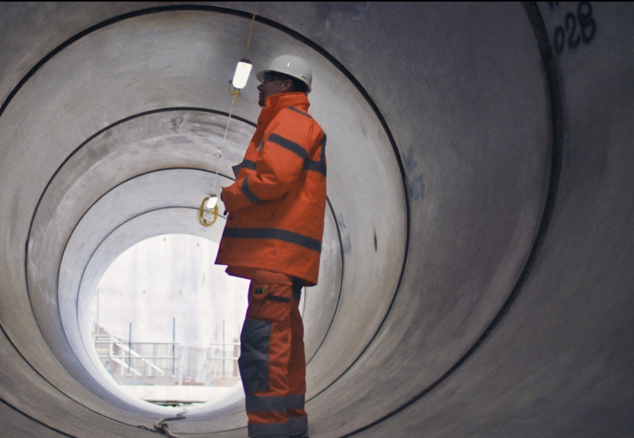
26
A Question of Net Zero | NOT PROTECTIVELY MARKED* © Copyright 2019 NNB Generation Company (HPC) Limited. All rights reserved.
Notes:
You’ve reached the end of the quiz! To find more curriculum and careers-linked teaching resources, visit www.edfenergy.com/hpcinspire#resources
And we’d really appreciate it if you could share your feedback on this activity at https://www.surveymonkey.co.uk/r/HPCInspire

